Slide 1

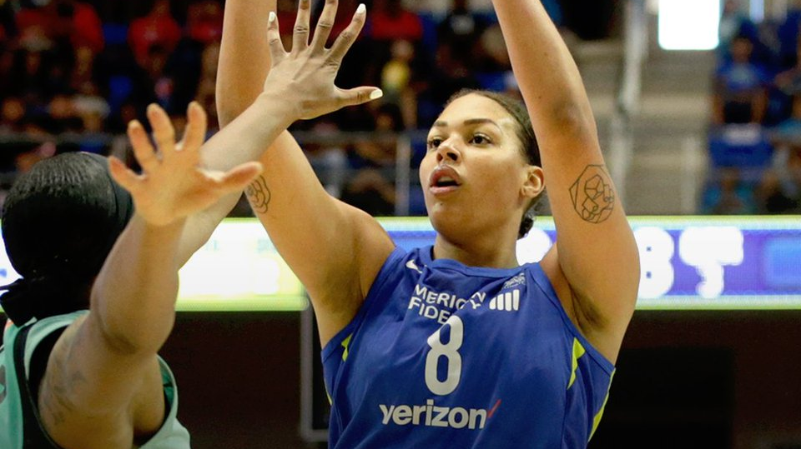

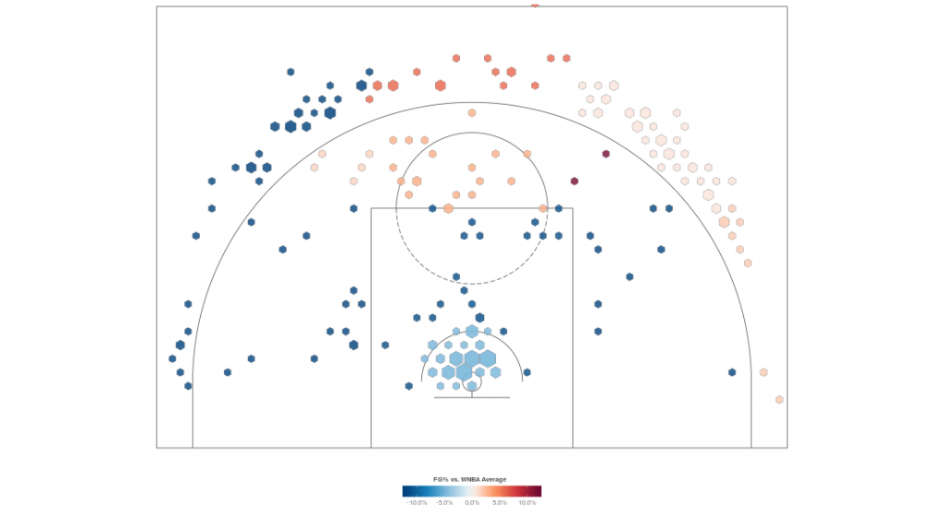
Shot Location Trends: 2015-2018

Slide 2
Contents:
Basketball Analytics 101: Expected Value (EV) and Points Per Shot Based on Distance
Downloading PDF files in R
Summarize and Mold Data
Visualize Data with Bar Charts
Fun Analysis of Players and Teams
Q&A

Slide 3
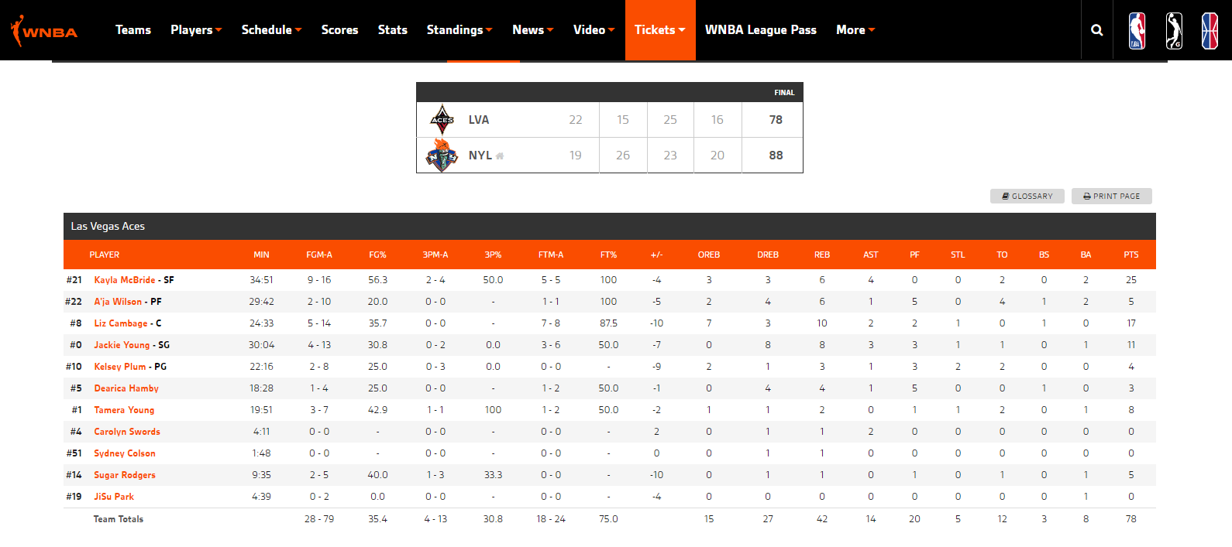
Traditional Boxscore w FG%

Slide 4
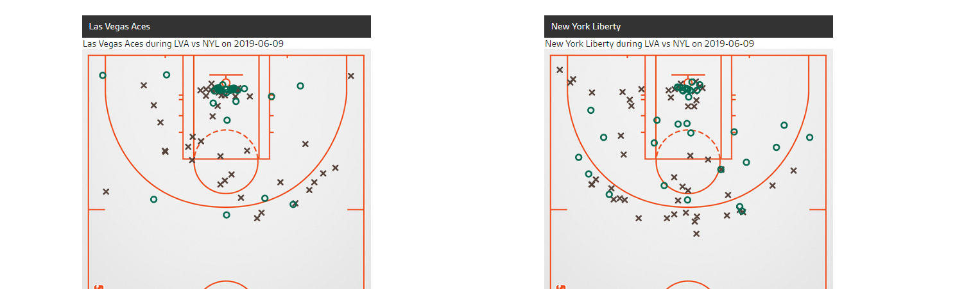

Shot Locations

Slide 5
Simple PPA (Points Per Attempt)
% Shots Made | Shot Value | Shots Attempted | PPA (Points per Attempt)
50% | 2 | 100 | 1.00
35% | 3 | 100 | 1.05

Slide 6
Detailed PPA (Points Per Attempt)
Shot Description | Shot Shots Made | Shot Value | Shots Attempted | PPA (Points per Attempt)
Layup | 65% | 2 | 100 | 1.30
Long 2 (>15’) | 30% | 2 | 100 | 0.60
Free Throw | 85% | 1 | 100 | 0.85
Elite 3 Point Shooter | 43% | 3 | 100 | 1.29

Slide 7
Total Points Scored at 80 Shots Attempted
PPA | Total Score
0.70 PPA | 56 Points
0.85 PPA | 68 Points
1.00 PPA | 80 Points
1.25 PPA | 100 Points

Slide 8
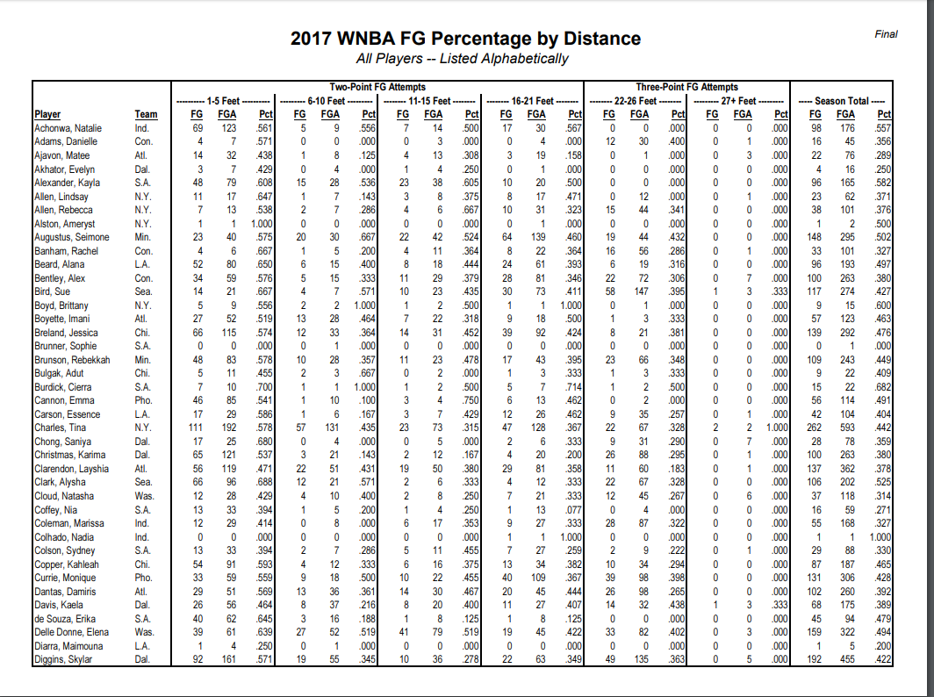
Raw Data – PDF File

Slide 9
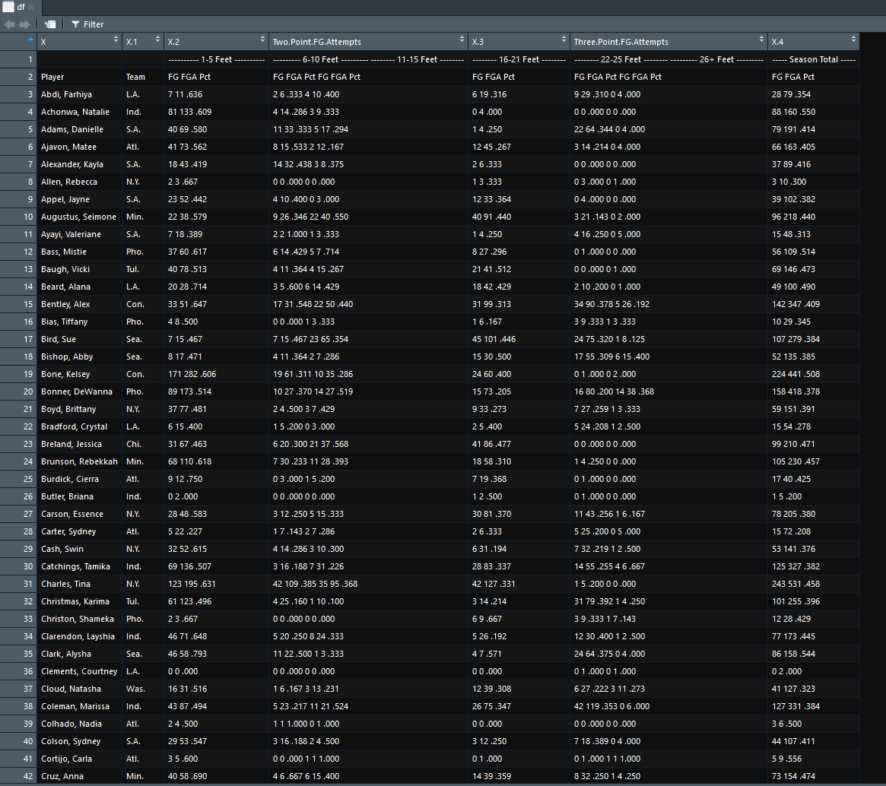
Imported Data Using Tabulizer

Slide 10
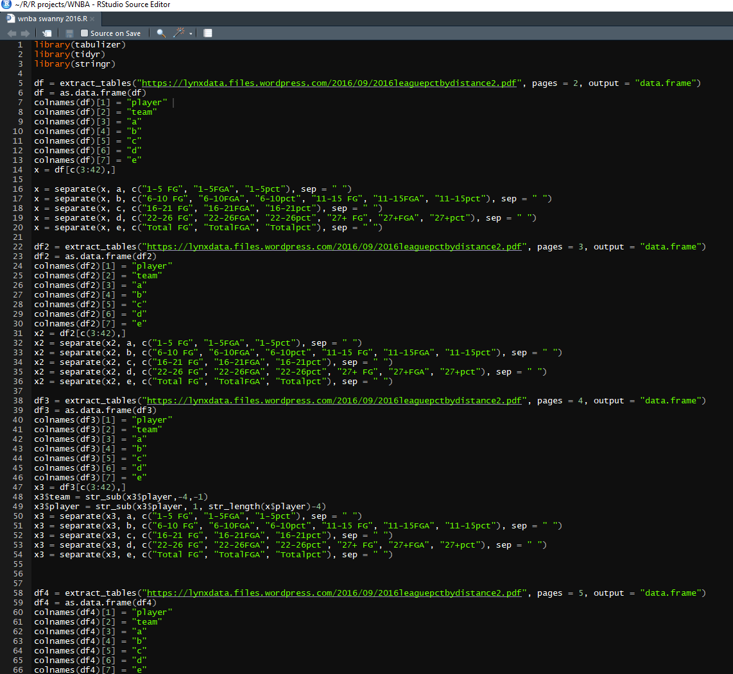
Packages Used to Clean Data:
Tabulizer
Tidyr
Stringr

Slide 11
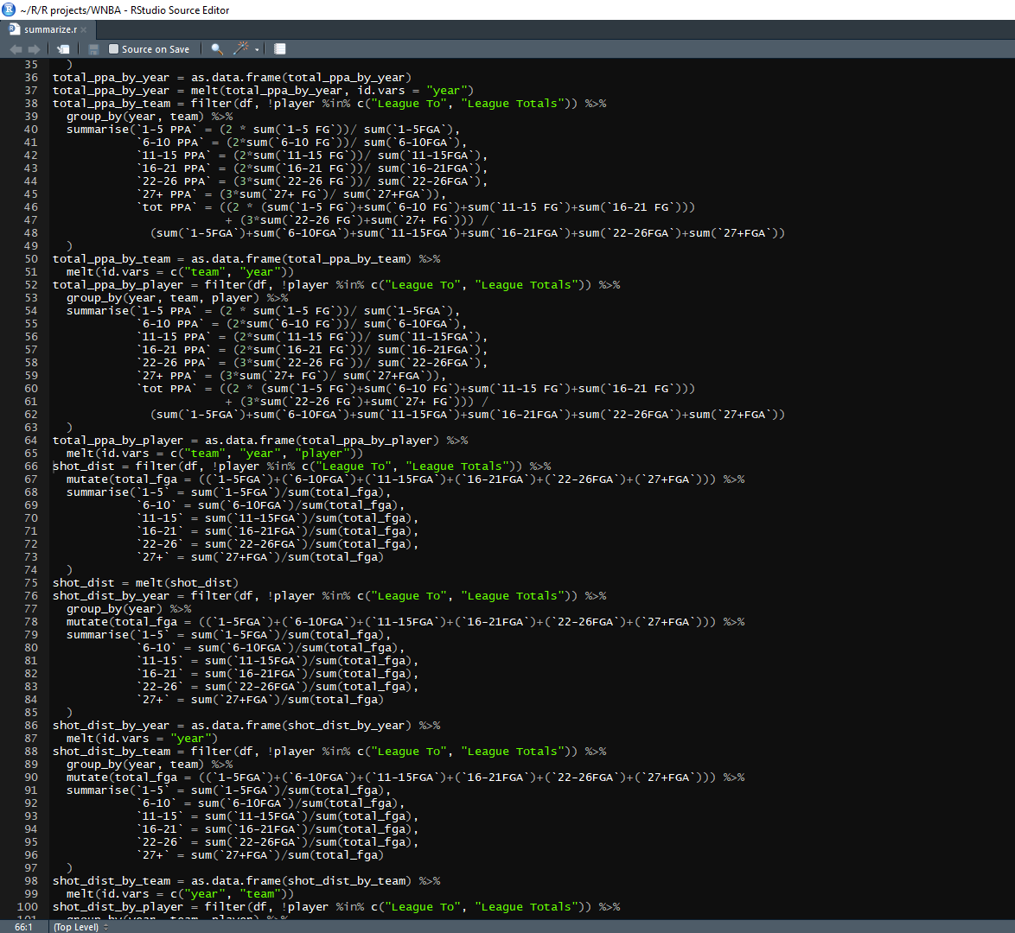
Packages used to summarize, mold, and visualize data:
Dplyr
Reshape
Ggplot2

Slide 12
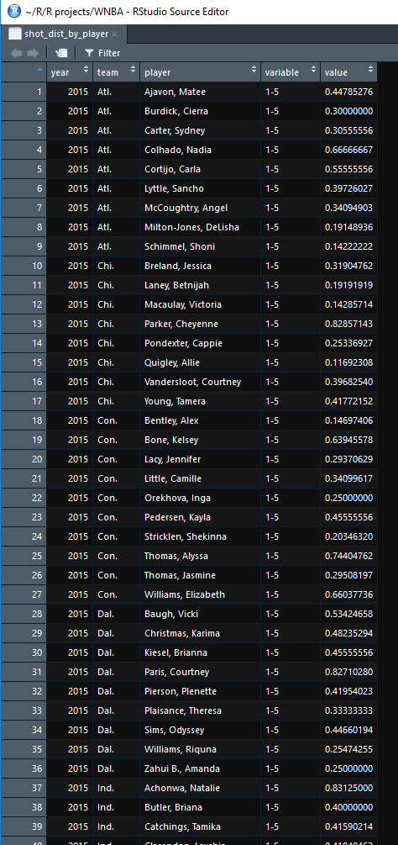
Wide Data to Long Data:

Slide 13
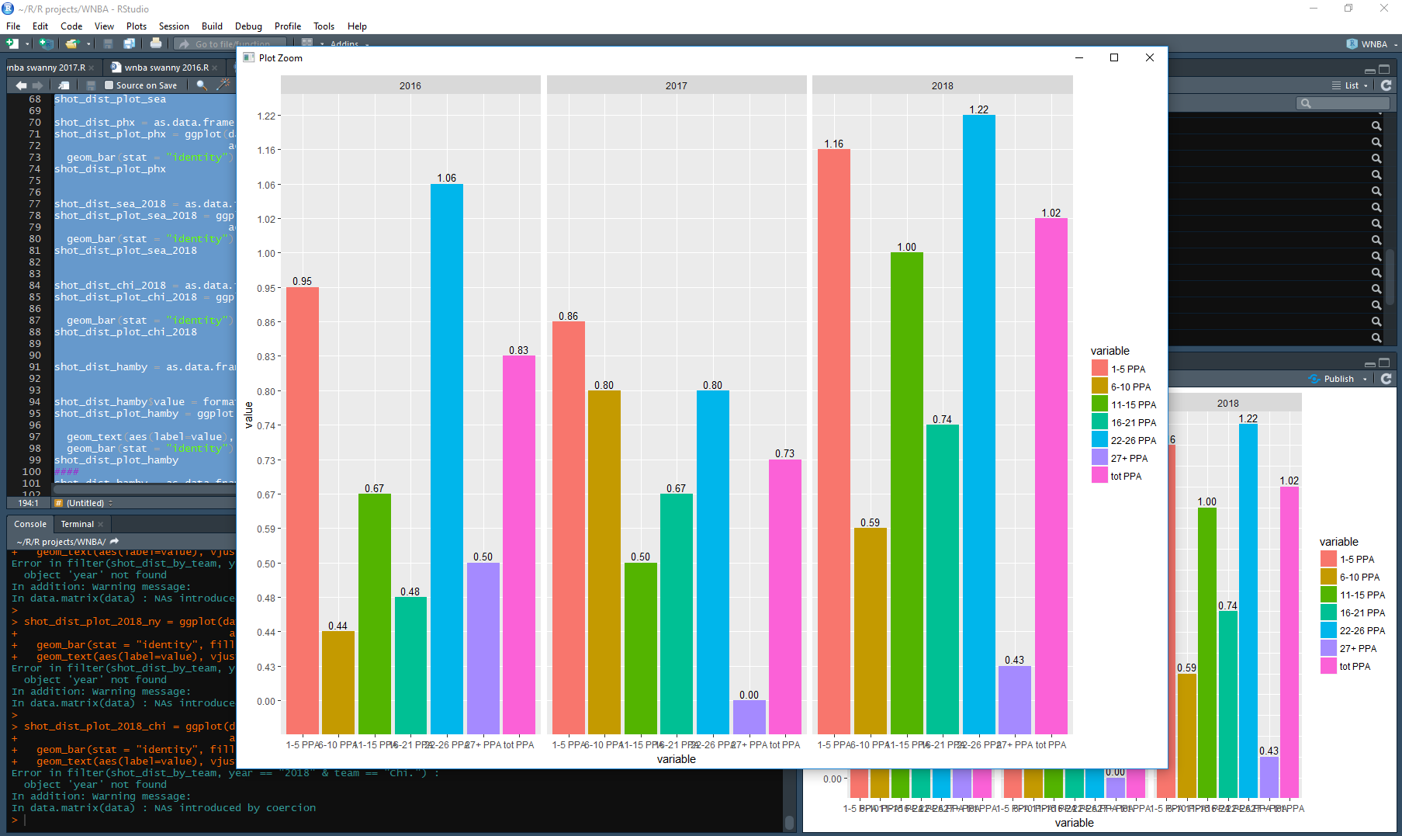
Visualizations:
ggplot2

Slide 14

Let’s put it all together!

Slide 15
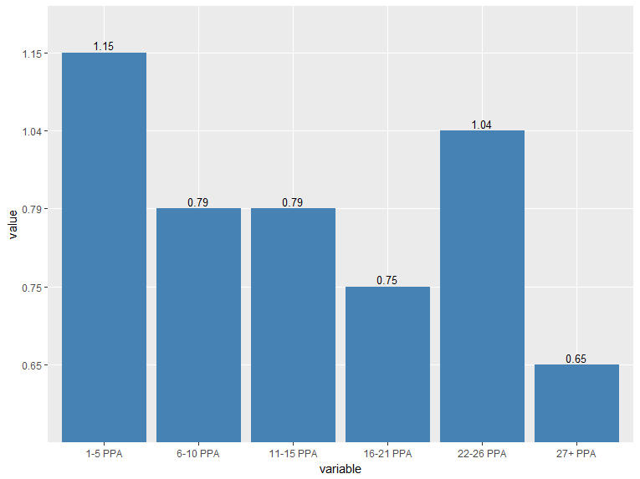
PPA (Points Per Shot Attempt)

Slide 16
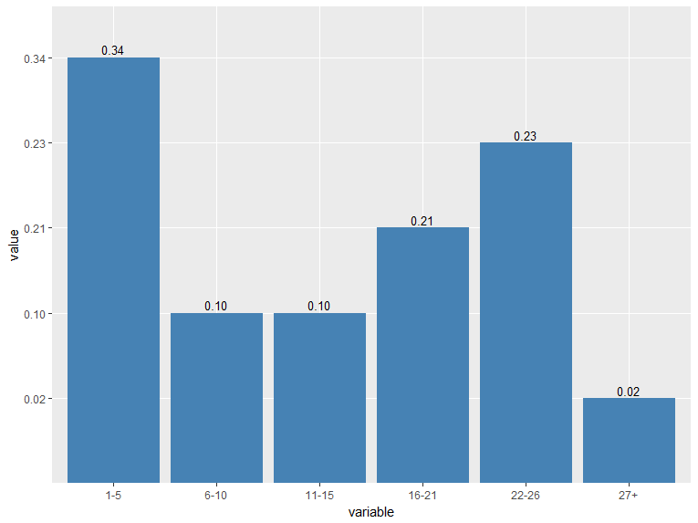
Shot Location Distribution

Slide 17
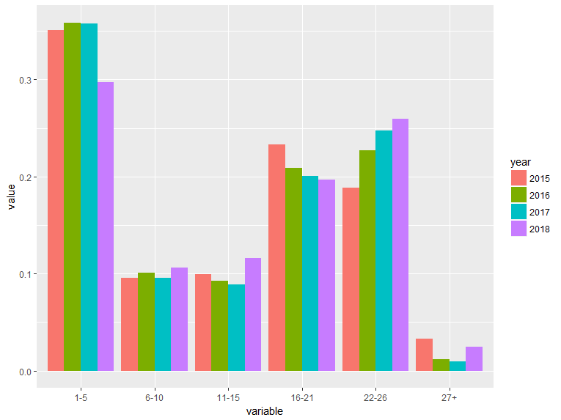
Shot Location Distribution – Year Over Year Change

Slide 18
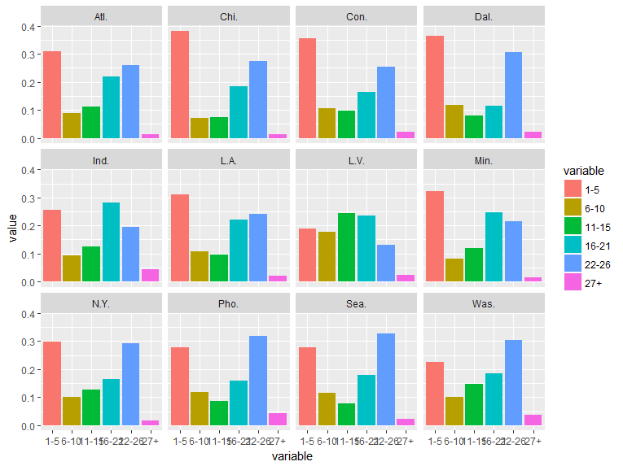
Shot Location Distribution – 2018 By Team

Slide 19
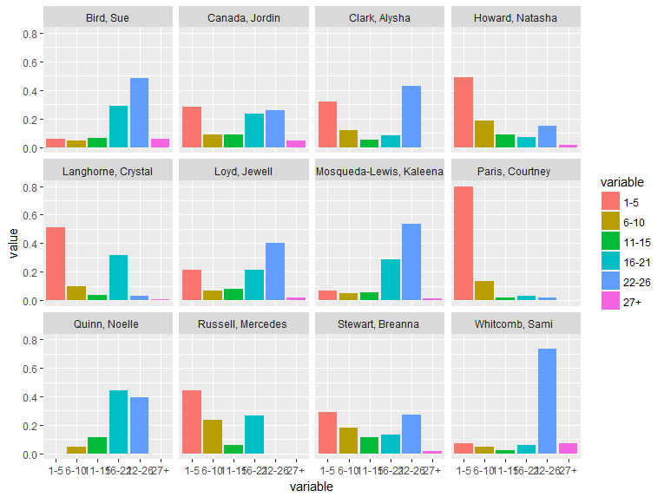
Shot Location Distribution – 2018 Seattle Storm Roster

Slide 20

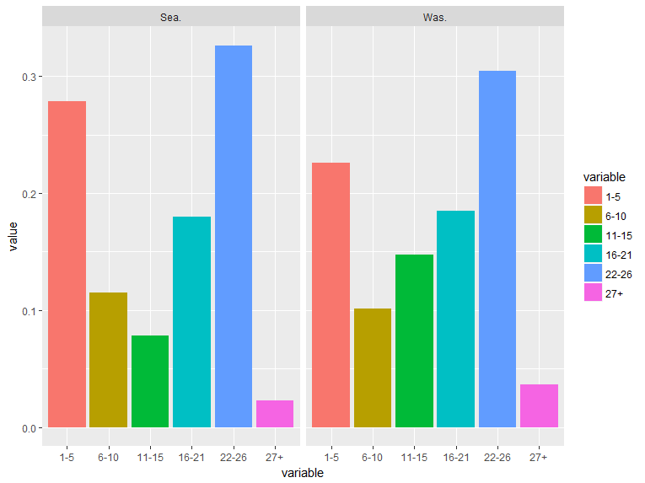


Slide 21

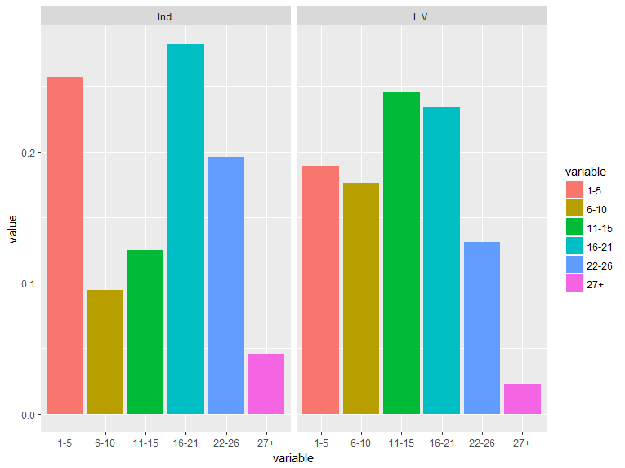

Slide 22

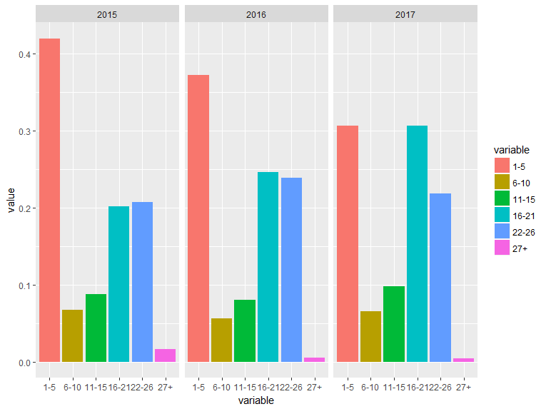


Slide 23
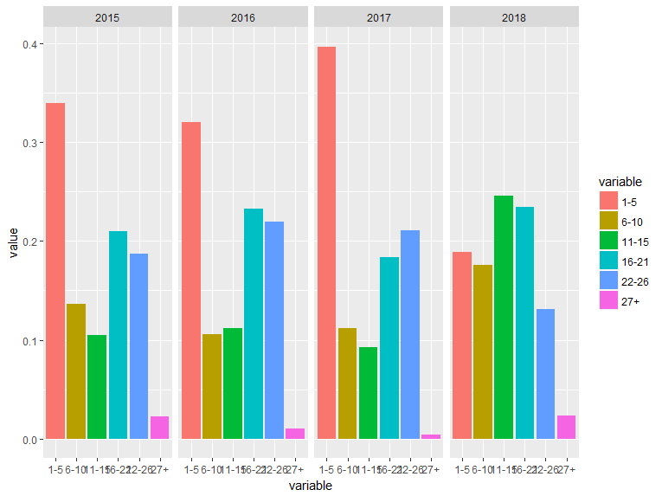
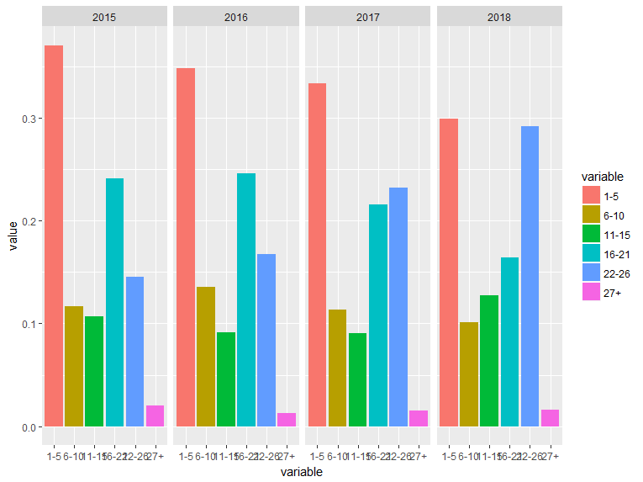


Slide 24
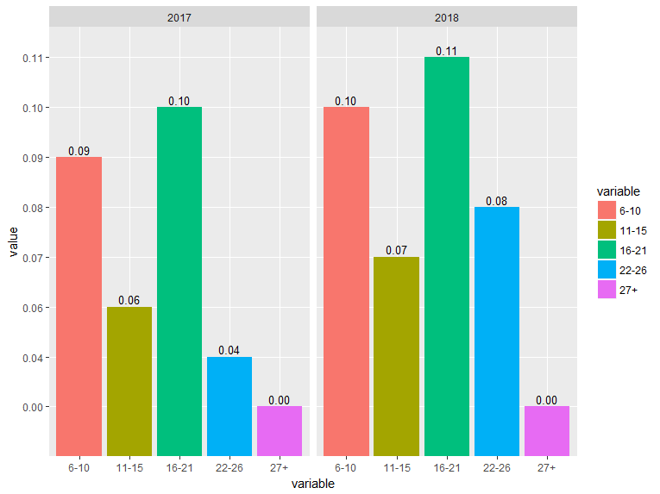
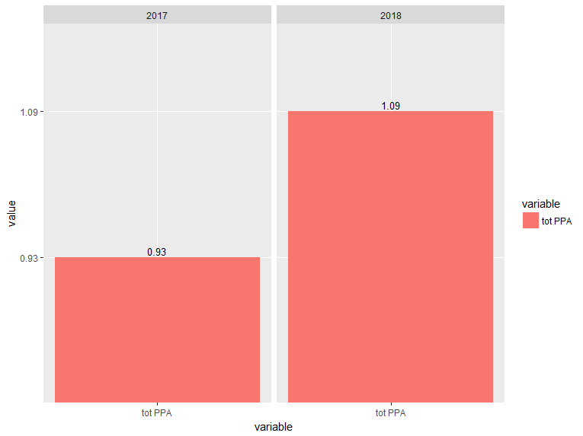


Slide 25
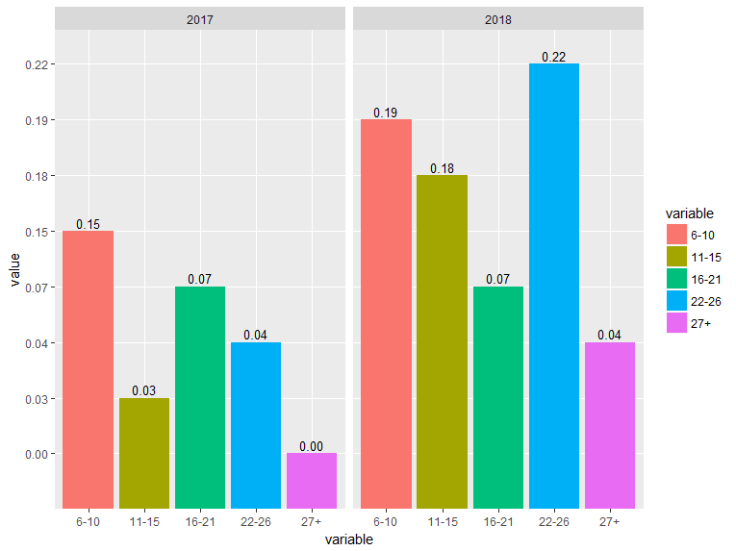



Slide 26
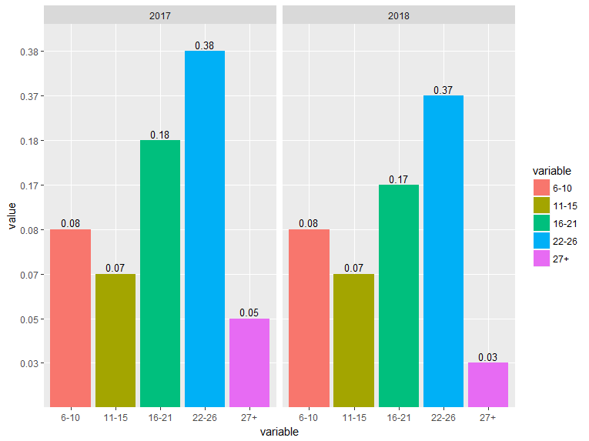



Slide 27

What’s Next?
Free Throw Data
Pace Data
Lineup Data
Shot Clock Data
Shiny Dashboard!

Slide 28
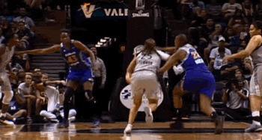
Thanks! jmizel312@gmail.com

